Slide 1
ESC101: Fundamentals of Computing
Sorting Algorithms
Piyush Rai

Slide 2
Announcement
End-sem lab exam on Nov 10
Wed, Thur batches: Morning session (10:30 – 1:30)
Mon, Tue batches: Afternoon session (2:00 – 5:00)
Arrive at least 15 minutes before the start of your session
Rest of the logistics will be similar to mid-sem lab exam
Room/seat allocation will be intimated to you in a couple of days
Course feedback has started (we will use the electronic version of the survey, not paper based – let’s please save paper). You would have received the email from DOAA/OARS.

Slide 3
Into the last 2 weeks of the semester..

Slide 4
What is Sorting?
“
Sorting is the process of arranging items systematically, ordered by some criterion
”

Slide 5
Your mind
Attending ESC101 class
Playing PUBG
Playing PUBG
Watching movies/web-series
Sorting
Watching movies/web-series
Sleeping in hall
Sleeping in hall
Sleeping in class
Sleeping in class
Attending ESC101 class

Slide 6
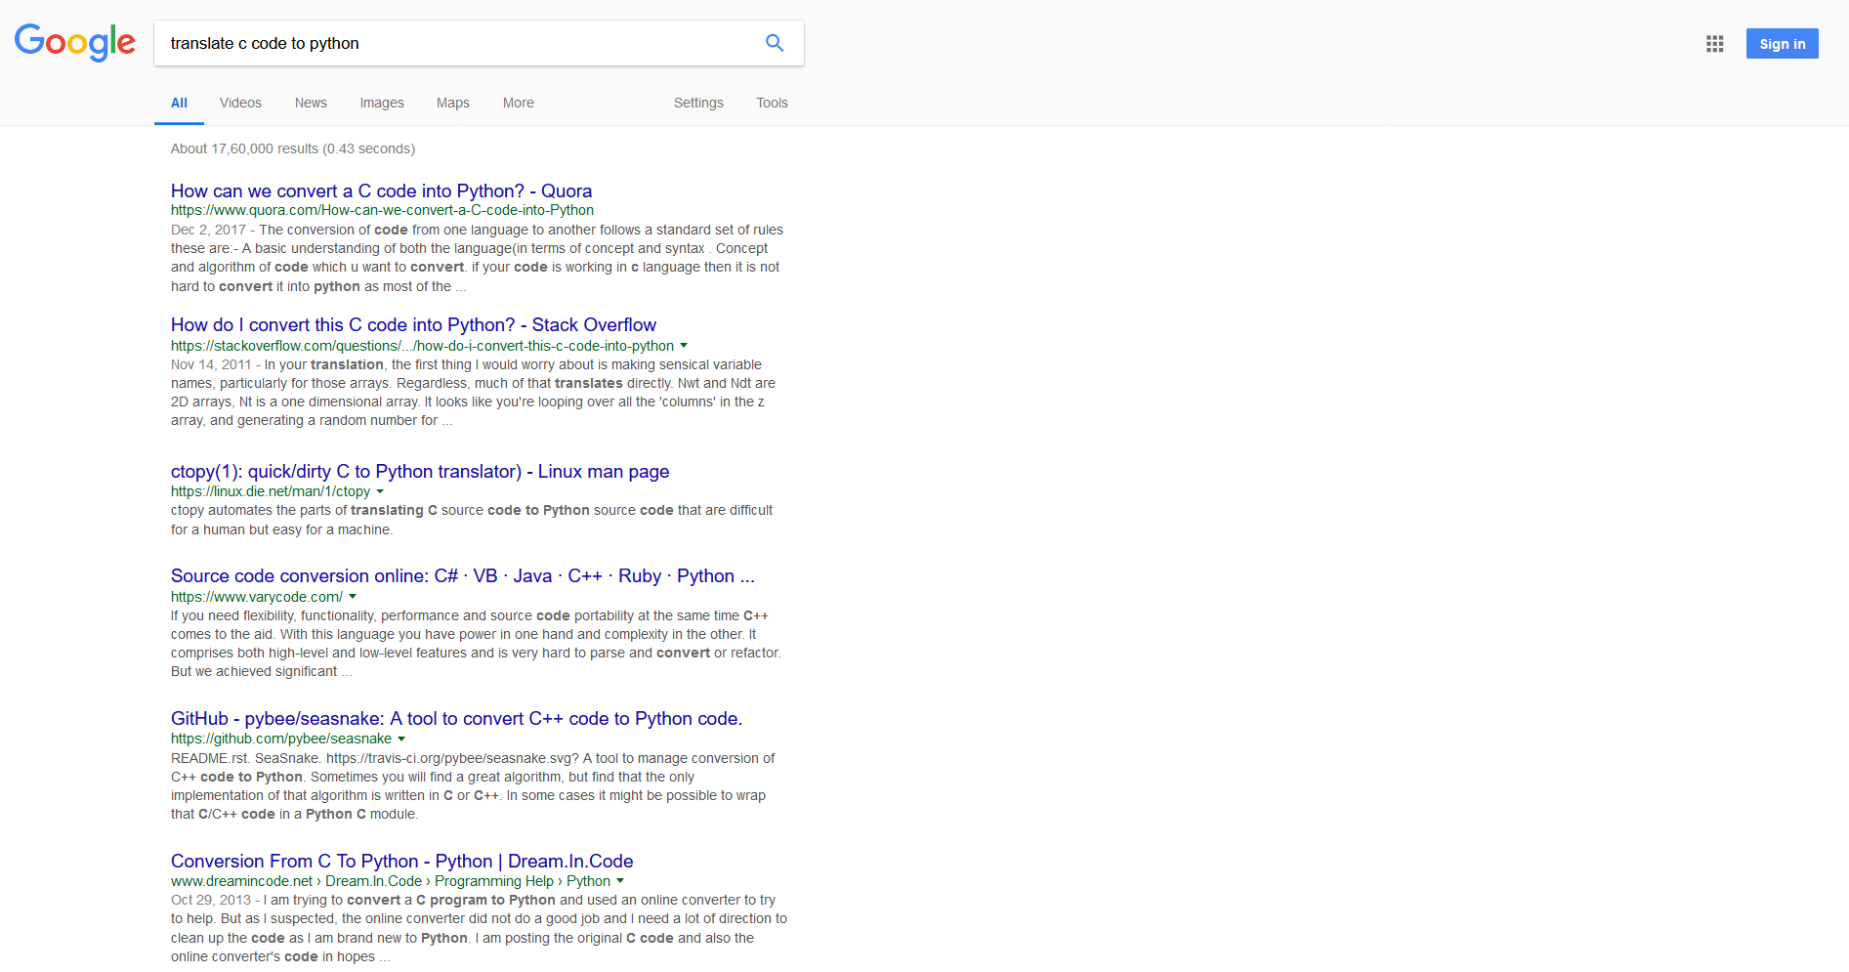
Internet Searches
Most relevant webpage
Google sorts webpages in decreasing relevance to the query you asked!
Less relevant webpage

Slide 7
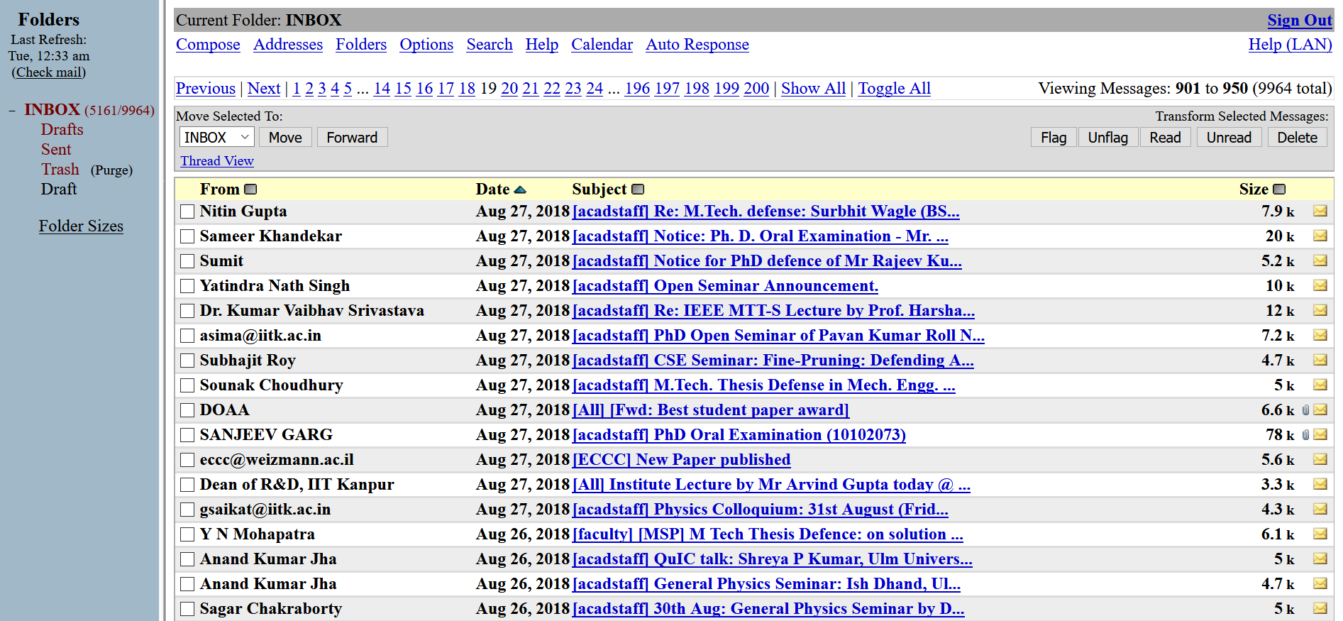
Email Clients
I can sort by date of receipt
I can sort by subject
I can sort by sender
I can sort by size of the mail
The same set of objects can be ordered by more than one criterion or “key”!
Sort criterion can be numeric (e.g. size, date, relevance) or lexicographic (e.g. alphabetic)

Slide 8
Applications of Sorting
The ability to order objects (webpages, emails, movies, songs) according to varied and user-dictated criteria can be lucrative
A subfield of machine learning called ranking is dedicated to this and has immense applications – recommendation systems (Amazon, Flipkart), internet search, personalized medicine
Profs especially love sorting since it helps them assign grades!
Sorting can also make other (less fancy) operations very simple
Agenda for the next couple of lectures
Look at a few applications of sorting
Look at a few efficient techniques of sorting
Get introduced to the divide and conquer technique

Slide 9
A useful application of sorting Search in Sorted Arrays

Slide 10
Brute Force Search
6
4
9
1
1
4
1
8
2
3
8
Is the element 4 present in the array?
Can search the array from left to right or right to left
for(i=0;i<11;i++) if(a[i]==4) return i; return -1;
for(i=10;i>=0;i--) if(a[i]==4) return i; return -1;
Searching from left seems faster for the query 4
Is the element 3 present in the array?
Is the element 5 present in the array?
If there are N elements in the array we have to do at least N operations (to verify absence) - can we do any better?

Slide 11
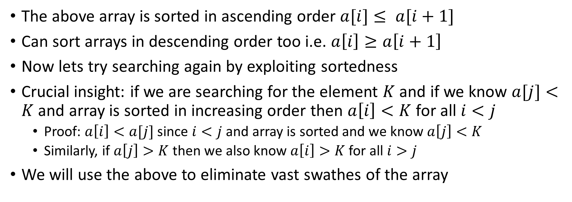
Binary Search
1
1
1
2
3
4
4
6
8
8
9
The above array is sorted in ascending order $a[i]≤ a[i+1]$
Can sort arrays in descending order too i.e. $a\left[i\right]≥a\left[i+1\right]$
Now lets try searching again by exploiting sortedness
Crucial insight: if we are searching for the element $K$ and if we know $a[j]<K$and array is sorted in increasing order then $a\left[i\right]<K$for all $i<j$
Proof: $a\left[i\right]<a[j]$ since $i<j$ and array is sorted and we know $a\left[j\right]<K$
Similarly, if $a\left[j\right]>K$then we also know $a\left[i\right]>K$for all $i>j$
We will use the above to eliminate vast swathes of the array

Slide 12
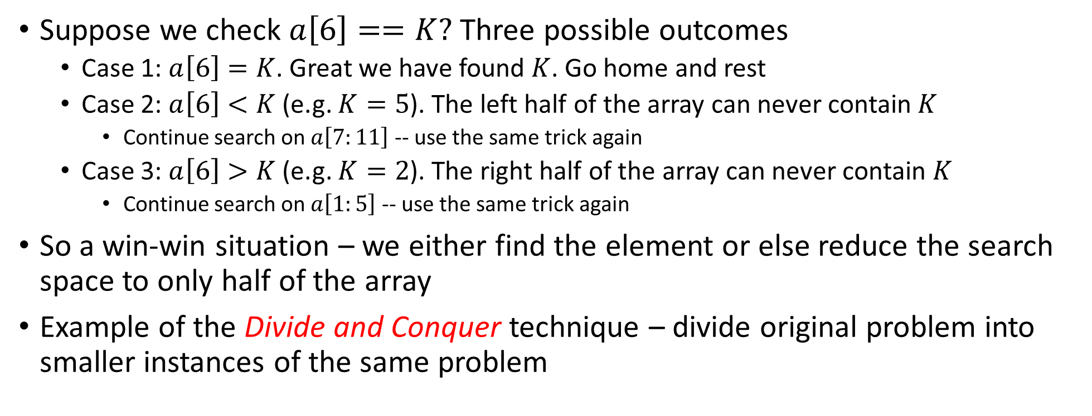
Binary Search
1
1
1
2
3
4
4
6
8
8
9
Suppose we check $a\left[6\right]==K?$ Three possible outcomes
Case 1: $a\left[6\right]=K$. Great we have found $K$. Go home and rest
Case 2: $a\left[6\right]<K$ (e.g. $K=5$). The left half of the array can never contain $K$
Continue search on $a\left[7:11\right]$ -- use the same trick again
Case 3: $a\left[6\right]>K$ (e.g. $K=2$). The right half of the array can never contain $K$
Continue search on $a\left[1:5\right]$ -- use the same trick again
So a win-win situation – we either find the element or else reduce the search space to only half of the array
Example of the Divide and Conquer technique – divide original problem into smaller instances of the same problem

Slide 13
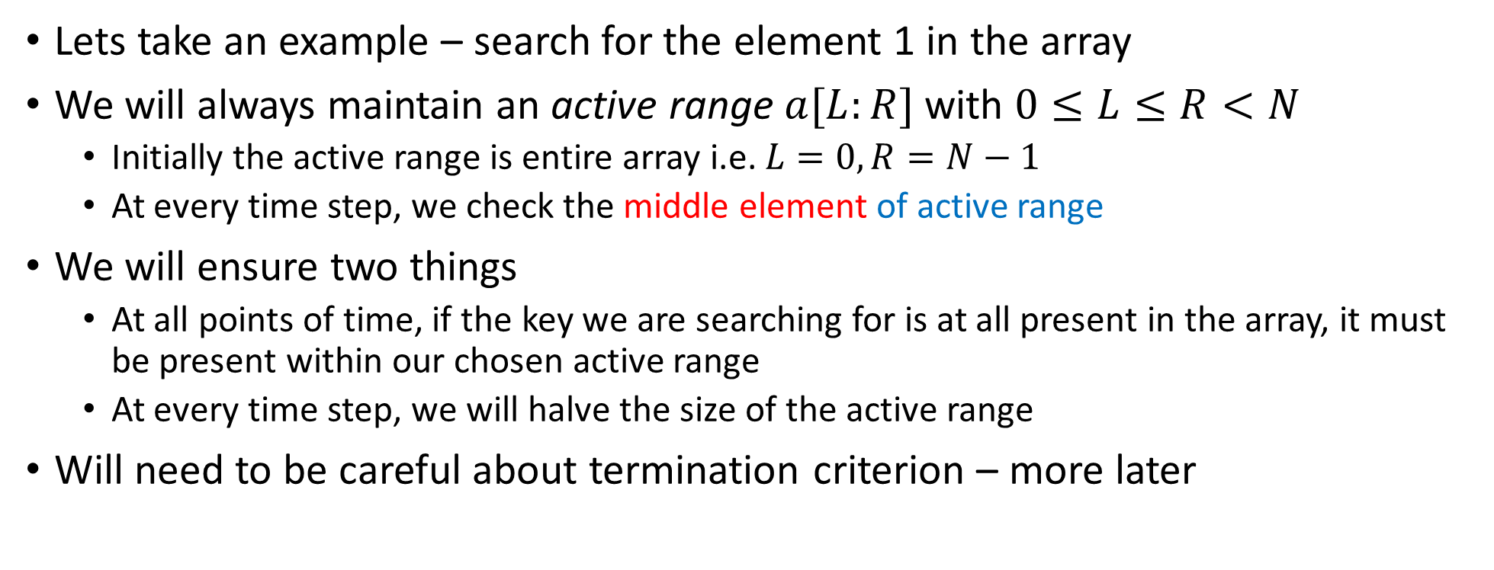
Binary Search
1
1
1
2
3
4
4
6
8
8
9
Lets take an example – search for the element 1 in the array
We will always maintain an active range $a[L:R]$ with $0≤L≤R<N$
Initially the active range is entire array i.e. $L=0,R=N−1$
At every time step, we check the middle element of active range
We will ensure two things
At all points of time, if the key we are searching for is at all present in the array, it must be present within our chosen active range
At every time step, we will halve the size of the active range
Will need to be careful about termination criterion – more later

Slide 14
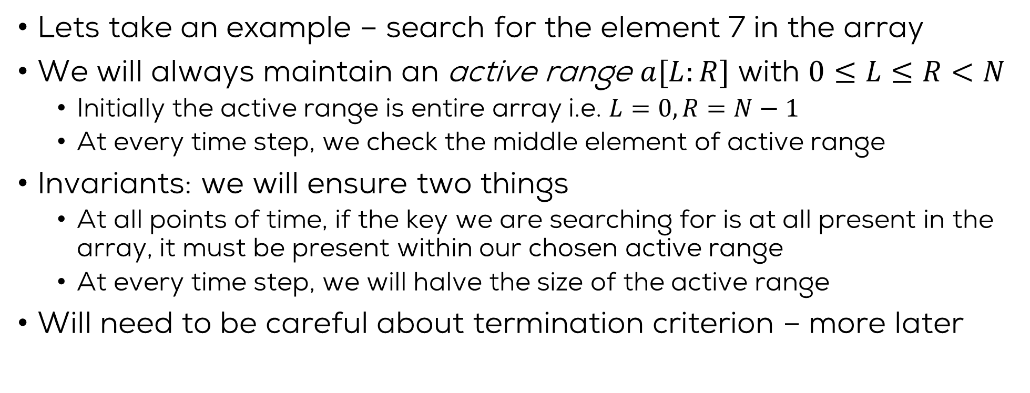
Binary Search
1
1
1
2
3
4
4
6
8
8
9
Lets take an example – search for the element 7 in the array
We will always maintain an active range $a[L:R]$ with $0≤L≤R<N$
Initially the active range is entire array i.e. $L=0,R=N−1$
At every time step, we check the middle element of active range
Invariants: we will ensure two things
At all points of time, if the key we are searching for is at all present in the array, it must be present within our chosen active range
At every time step, we will halve the size of the active range
Will need to be careful about termination criterion – more later

Slide 15
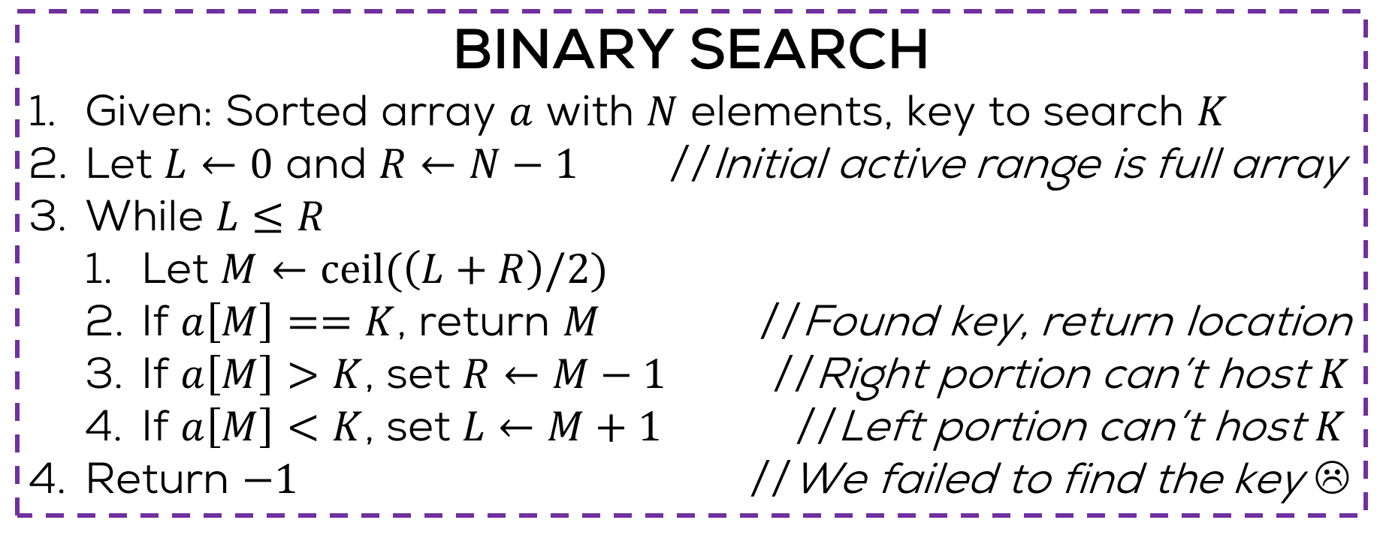
Binary Search
Exercise: write a recursive version
Exercise: convert this to proper C code
BINARY SEARCH
Given: Sorted array $a$ with $N$ elements, key to search $K$
Let $L←0$ and $R←N−1$ //Initial active range is full array
While $L≤R$
Let $M←ceil(\left(L+R\right)/2)$
If $a\left[M\right]==K$, return $M$ //Found key, return location
If $a\left[M\right]>K$, set $R←M−1$ //Right portion can’t host $K$
If $a\left[M\right]<K$, set $L←M+1$ //Left portion can’t host $K$
Return $−1$ //We failed to find the key ☹
The above is often known as pseudo code, something that gives details of an algorithm but does not strictly follow rules of C or any other programming language

Slide 16
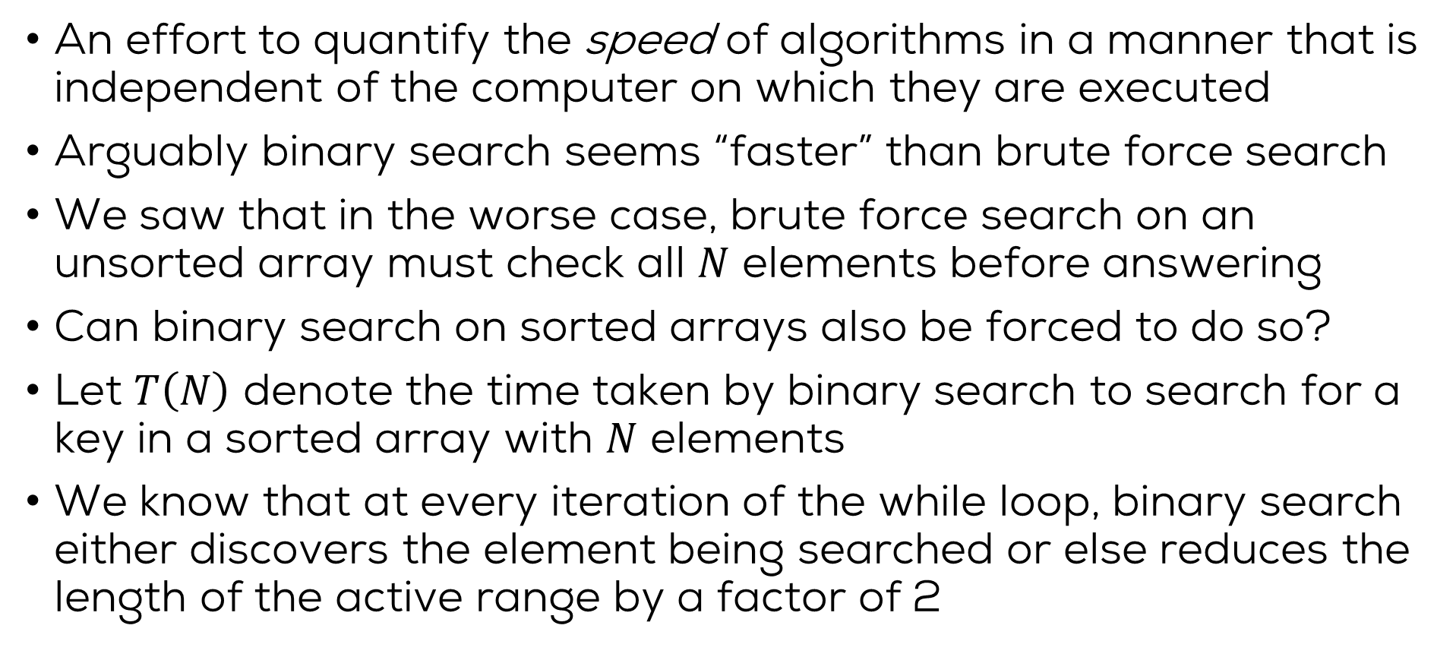
Asymptotic Time Complexity
An effort to quantify the speed of algorithms in a manner that is independent of the computer on which they are executed
Arguably binary search seems “faster” than brute force search
We saw that in the worse case, brute force search on an unsorted array must check all $N$ elements before answering
Can binary search on sorted arrays also be forced to do so?
Let $T\left(N\right)$ denote the time taken by binary search to search for a key in a sorted array with $N$ elements
We know that at every iteration of the while loop, binary search either discovers the element being searched or else reduces the length of the active range by a factor of 2

Slide 17
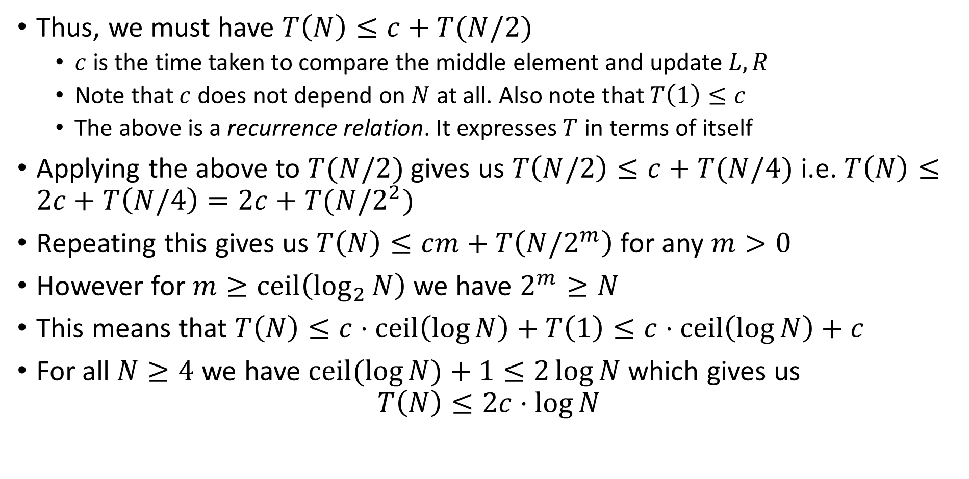
Asymptotic Time Complexity
Thus, we must have $T\left(N\right)≤c+T(N/2)$
$c$ is the time taken to compare the middle element and update $L,R$
Note that $c$ does not depend on $N$ at all. Also note that $T\left(1\right)≤c$
The above is a recurrence relation. It expresses $T$ in terms of itself
Applying the above to $T(N/2)$ gives us $T\left(N/2\right)≤c+T(N/4)$ i.e. $T\left(N\right)≤2c+T\left(N/4\right)=2c+T(N/2^{2})$
Repeating this gives us $T\left(N\right)≤cm+T\left(N/2^{m}\right)$ for any $m>0$
However for $m≥ceil\left(\log_{2}{N}\right)$ we have $2^{m}≥N$
This means that $T\left(N\right)≤c⋅ceil\left(\log{N}\right)+T\left(1\right)≤c⋅ceil\left(\log{N}\right)+c$
For all $N≥4$ we have $ceil(log{N)}+1≤2\log{N}$ which gives us $T\left(N\right)≤2c⋅\log{N}$

Slide 18
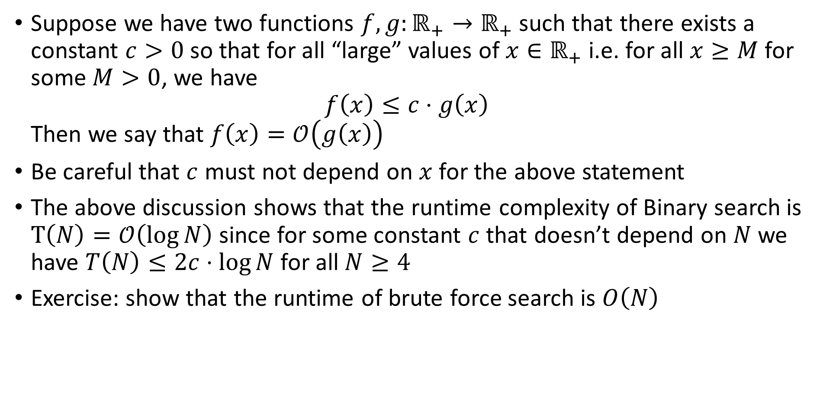
Big-Oh Notation
Suppose we have two functions $f,g:ℝ_{+}→ℝ_{+}$ such that there exists a constant $c>0$ so that for all “large” values of $x∈ℝ_{+}$ i.e. for all $x≥M$ for some $M>0$, we have $f\left(x\right)≤c⋅g\left(x\right)$ Then we say that $f\left(x\right)=𝒪\left(g\left(x\right)\right)$
Be careful that $c$ must not depend on $x$ for the above statement
The above discussion shows that the runtime complexity of Binary search is $T\left(N\right)=𝒪\left(\log{N}\right)$ since for some constant $c$ that doesn’t depend on $N$ we have $T\left(N\right)≤2c⋅\log{N}$ for all $N≥4$
Exercise: show that the runtime of brute force search is $O\left(N\right)$

Slide 19
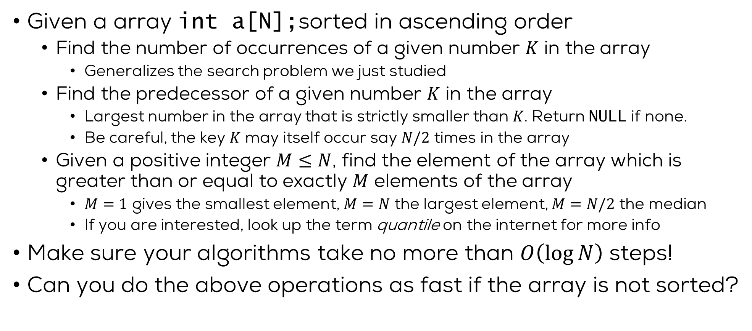
Exercises
Given a array int a[N];sorted in ascending order
Find the number of occurrences of a given number $K$ in the array
Generalizes the search problem we just studied
Find the predecessor of a given number $K$ in the array
Largest number in the array that is strictly smaller than $K$. Return NULL if none.
Be careful, the key $K$ may itself occur say $N/2$ times in the array
Given a positive integer $M≤N$, find the element of the array which is greater than or equal to exactly $M$ elements of the array
$M=1$ gives the smallest element, $M=N$ the largest element, $M=N/2$ the median
If you are interested, look up the term quantile on the internet for more info
Make sure your algorithms take no more than $O\left(\log{N}\right)$ steps!
Can you do the above operations as fast if the array is not sorted?

Slide 20
Back to Sorting..

Slide 21
Sorting Algorithms
Bubble Sort

Slide 22
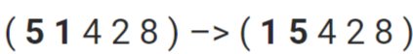
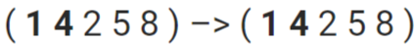
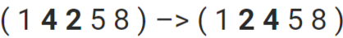
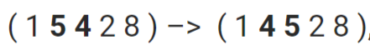

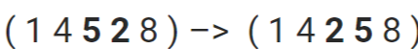
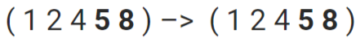
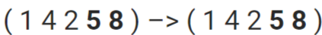
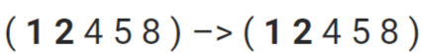
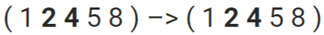

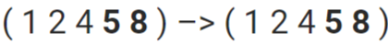
Bubble Sort
Consider an array (5 1 4 2 8). Goal: Sort it in ascending order
Idea: Repeatedly swap the adjacent elements if they are in wrong order
First Pass
Second Pass
Third Pass
No swaps in this pass,
hence done! ☺

Slide 23
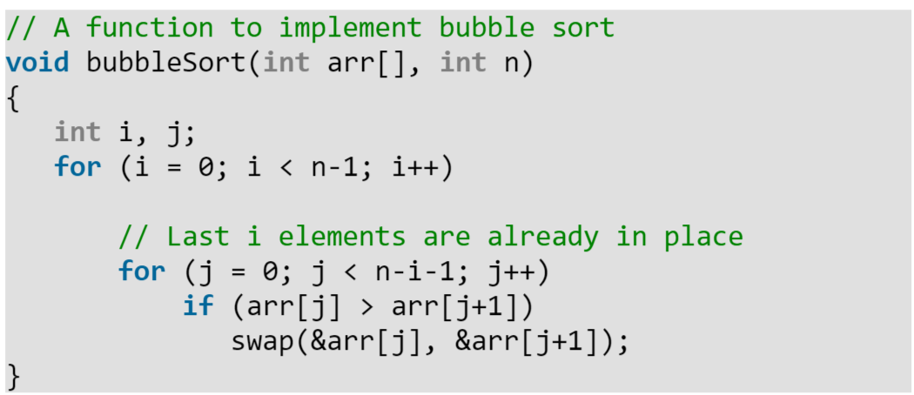
Bubble Sort

Slide 24
Sorting Algorithms
Selection Sort

Slide 25
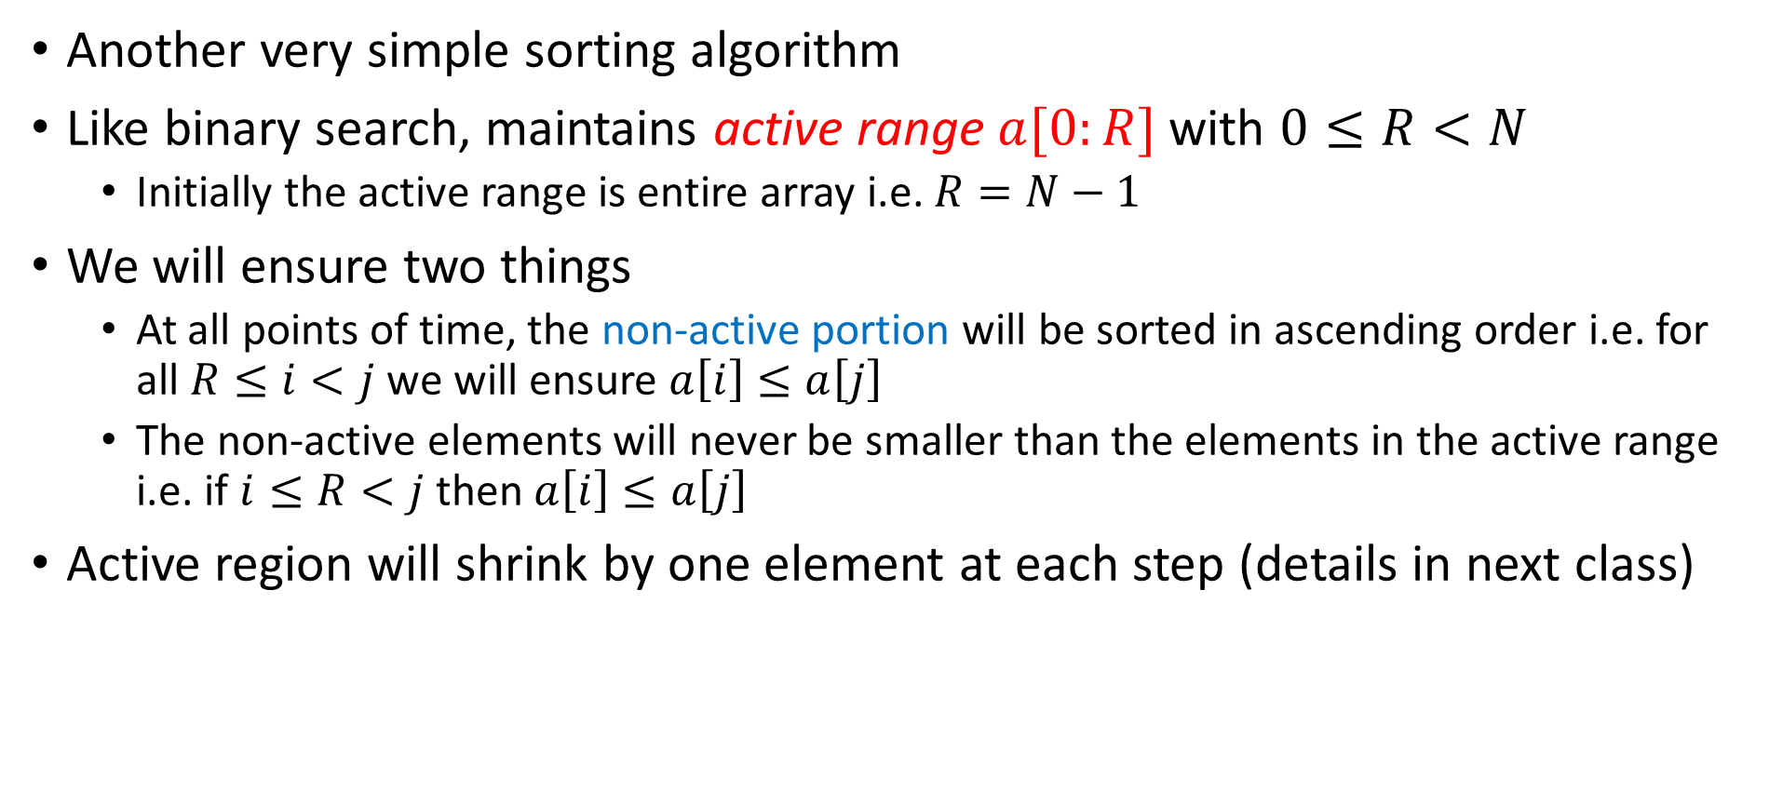
Selection Sort
Another very simple sorting algorithm
Like binary search, maintains active range $a[0:R]$ with $0≤R<N$
Initially the active range is entire array i.e. $R=N−1$
We will ensure two things
At all points of time, the non-active portion will be sorted in ascending order i.e. for all $R≤i<j$ we will ensure $a\left[i\right]≤a\left[j\right]$
The non-active elements will never be smaller than the elements in the active range i.e. if $i≤R<j$ then $a\left[i\right]≤a\left[j\right]$
Active region will shrink by one element at each step (details in next class)
4
1
3
5
6
8
9

Slide 26
Next Class..
Selection sort in more detail
Faster sorting algorithms
Merge Sort
Quick Sort

